Slide 1

Social Extension

Slide 2

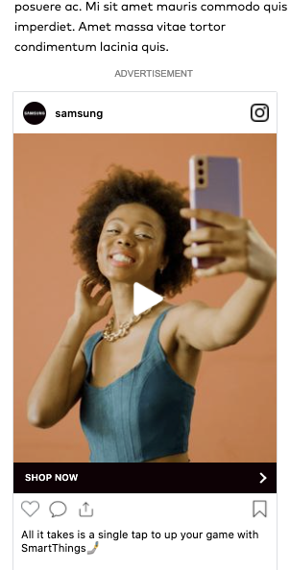
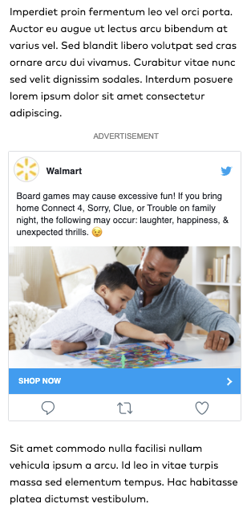
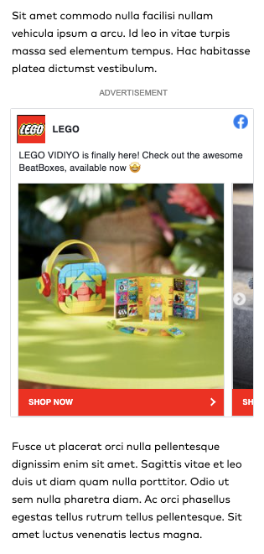








Social Extension and Video
Repurpose social creative
Brands repurpose their best creative from social to run in standard publisher display inventory on mobile, desktop and app.
Social Video
Social Image
Social Carousel
Visit socialdisplay.info to see examples

Slide 3
Activation workflows

Slide 4
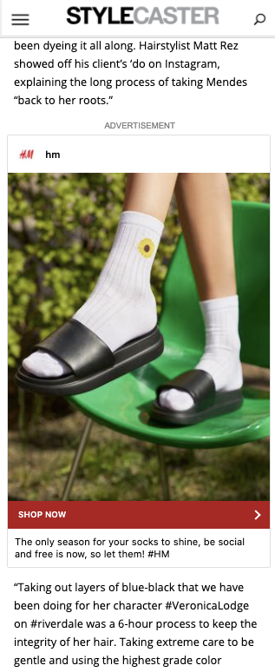
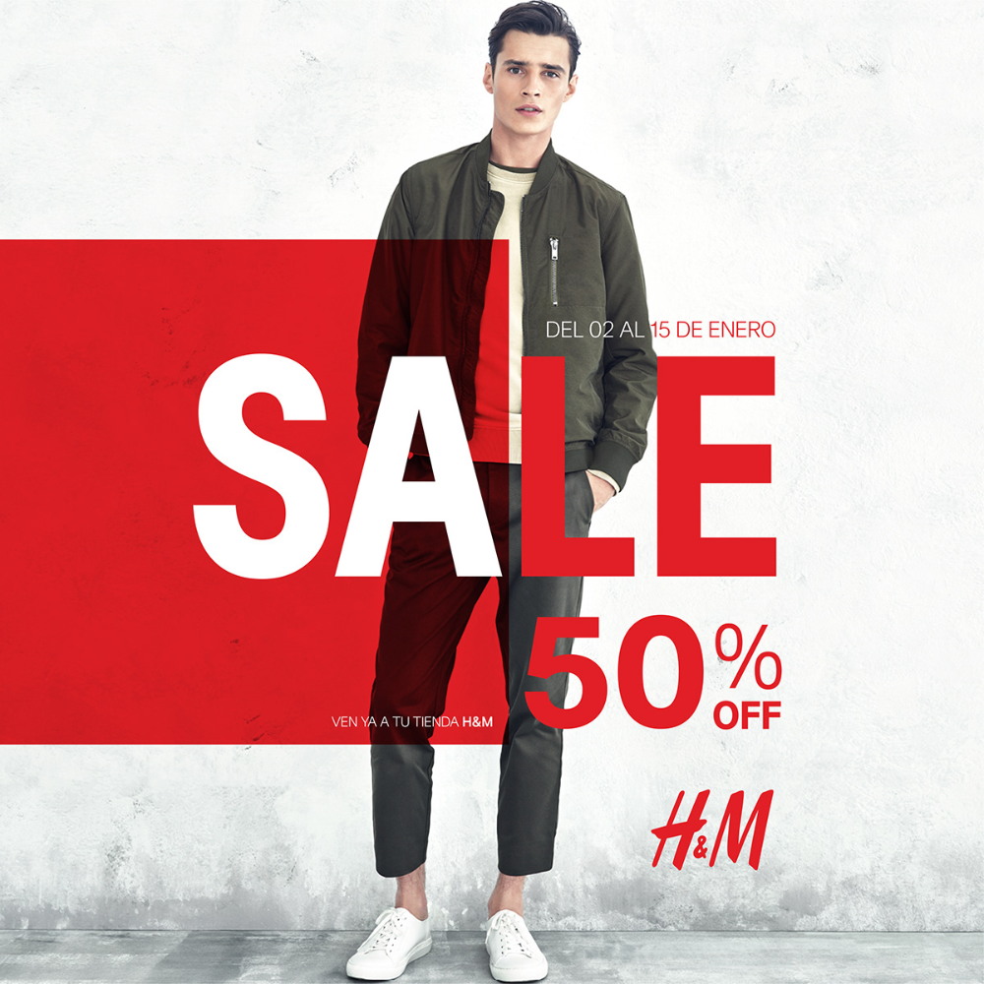
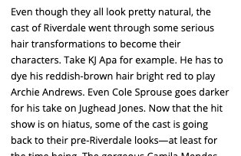
Inventory
Maximum flexibility
Owned & operated channels
Mobile web, desktop, mobile app
Standard display inventory
Existing 300x250, 300x600 placements
Developer-free
Activate via existing publisher ad server (e.g. GAM)
Intelligent resizing
Formats automatically render as high-impact sizes
BEFORE
AFTER

Slide 5

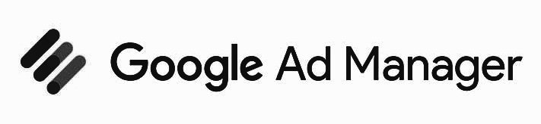














Delivery
Flexible workflows
Standard I/Os
Activate with the same workflows used for direct-sold today
Programmatic ready
Activate Social Extension tags with any DSP, ideal for PMPs

Slide 6









Measurement
Enterprise-grade
Publisher measurement
Standard ad metrics in publisher ad server (GAM)
Publisher viewability ready (ActiveView, Moat)
Third-party certified
Accept third-party impression and click trackers
Moat, IAS, DoubleVerify work out-of-the-box
Engagement reporting
Proprietary video and engagement metrics available

Slide 7
Client Benefits

Slide 8



Why Social Extension works
Efficient
Repurpose a brand’s existing creative assets from social or the web to eliminate production overhead
Engaging
Beautiful high-impact ad experiences that are familiar to users and that extend beyond standard banners
Effective
Designed to deliver the results that matter most for brands up-and-down the marketing funnel

Slide 9
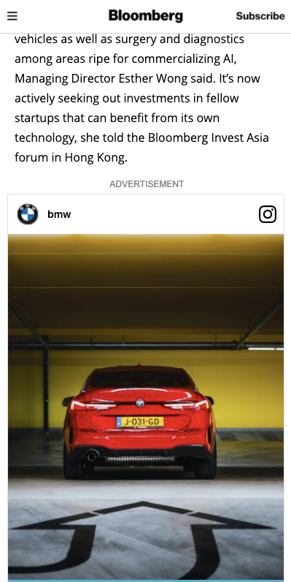
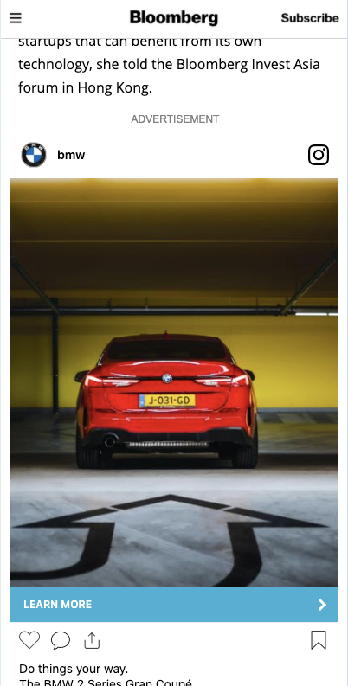

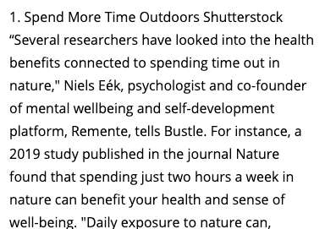
Boost performance
More site traffic
Ad solutions designed to deliver significantly better CTR performance for brands when compared to standard banner ads.
0.45%
Social Extension and Video CTR benchmark
4x
Higher CTR performance vs standard banners
BEFORE
AFTER

Slide 10


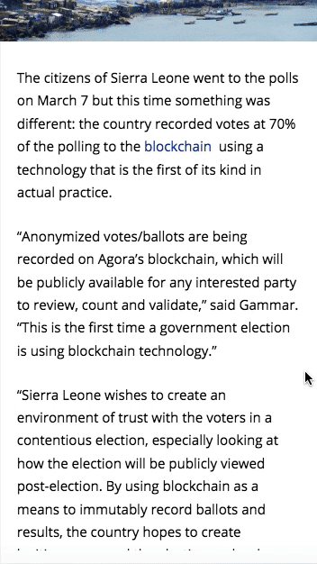
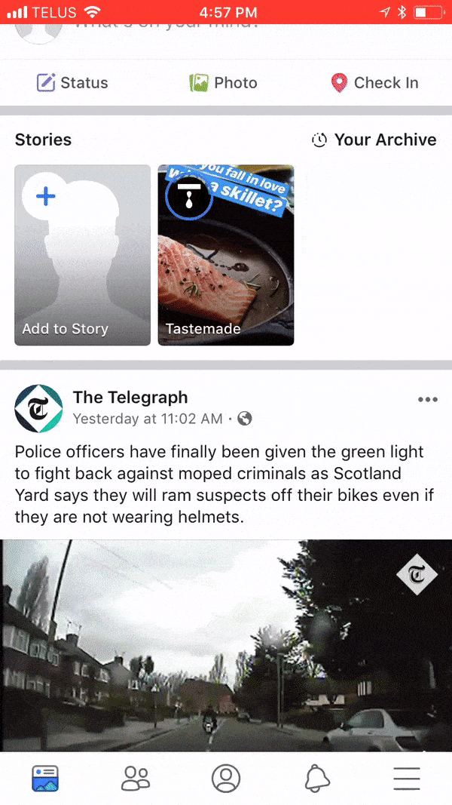
Increase attention
Better viewability
Publisher sites deliver significantly higher viewability and attention time when compared with social feeds.
9 secs
Average attention (in-view) time
3x
Higher attention and viewability vs Facebook
Facebook
Publisher Sites

Slide 11
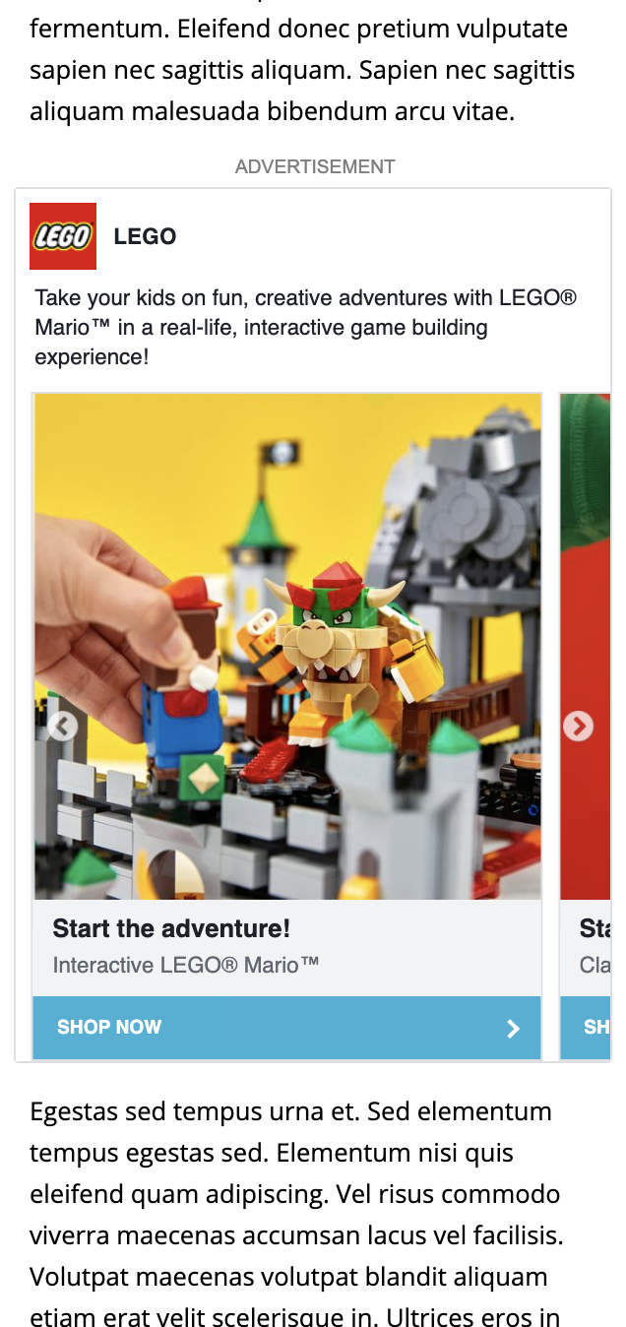
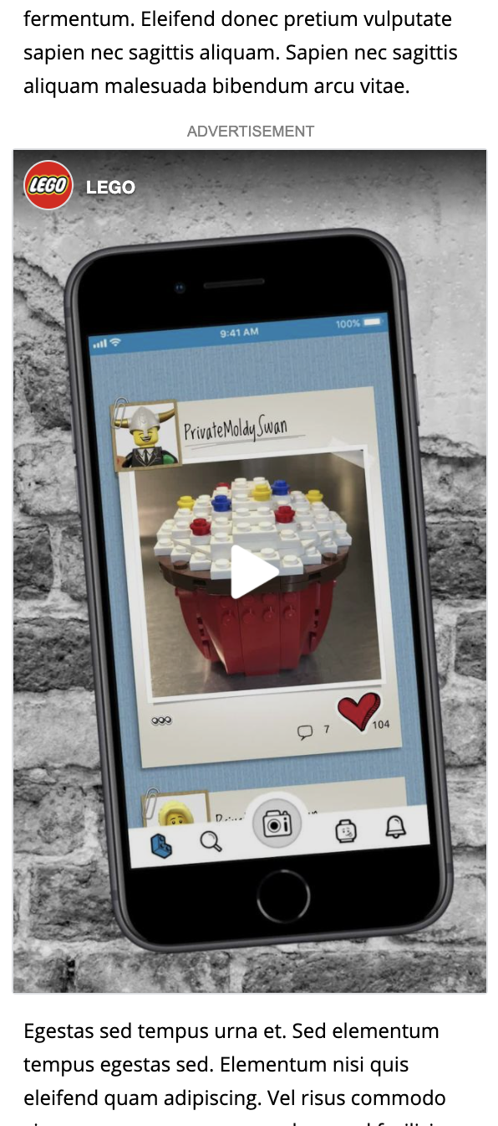
Effortless creative
Lower production overhead
Brands do not have the budget, time or patience to build new creative for additional media channels beyond the walled gardens.
-47%
Reduction in production costs vs building new ads
+25%
Average increase in creatives per campaign

Slide 12
Case Studies

Slide 13
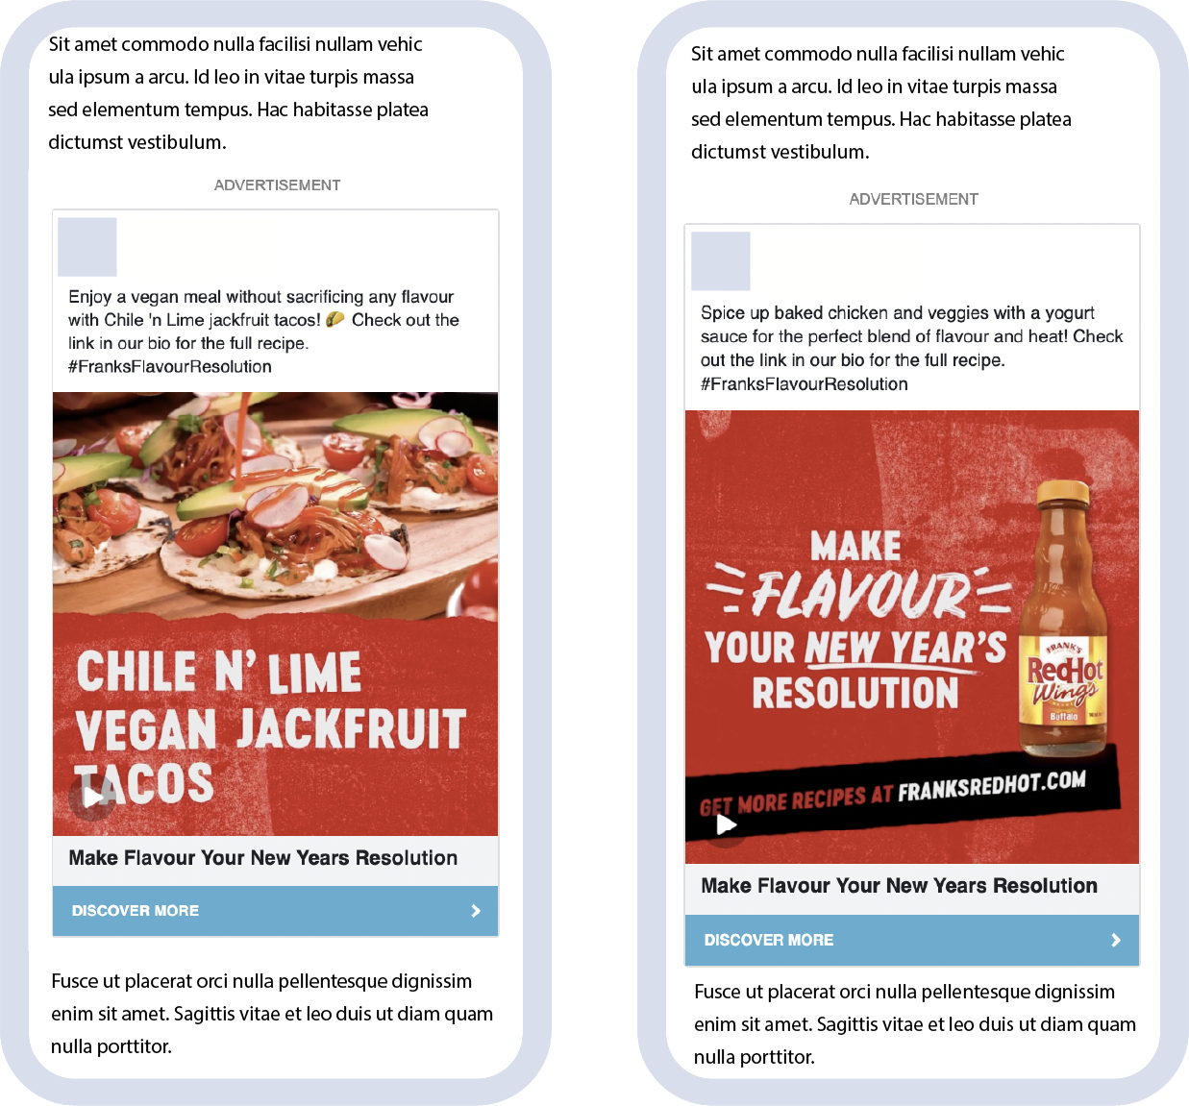
Hot Sauce Brand
Increased viewability
The brand saw 12 seconds of average attention time compared to only 4 seconds for the same creatives in the walled gardens. The average viewability on the open web was 77% compared to only 25% on social feeds.
3.1x
Increase in viewability vs Facebook
3.0x
Increase in attention time vs Facebook

Slide 14
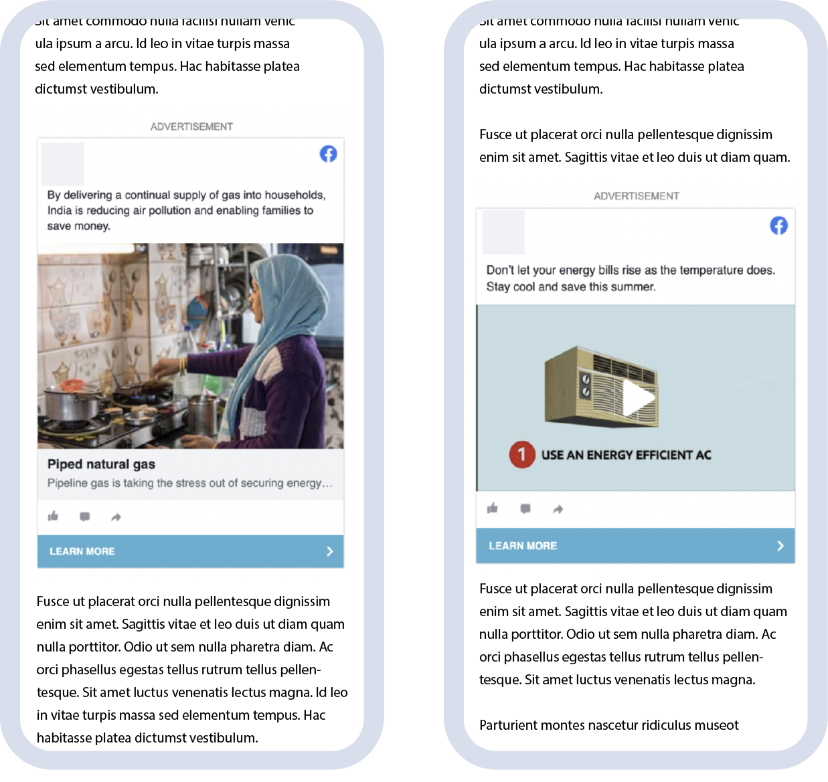
Global Energy Brand
Frictionless creative
Global energy brand activated 115 unique creatives with Social Extension in the past 6 months, making Social Extension an always-on strategy thanks to the ease of use.
150m
Ad impressions in 6 months
115
Unique creatives in 6 months

Slide 15
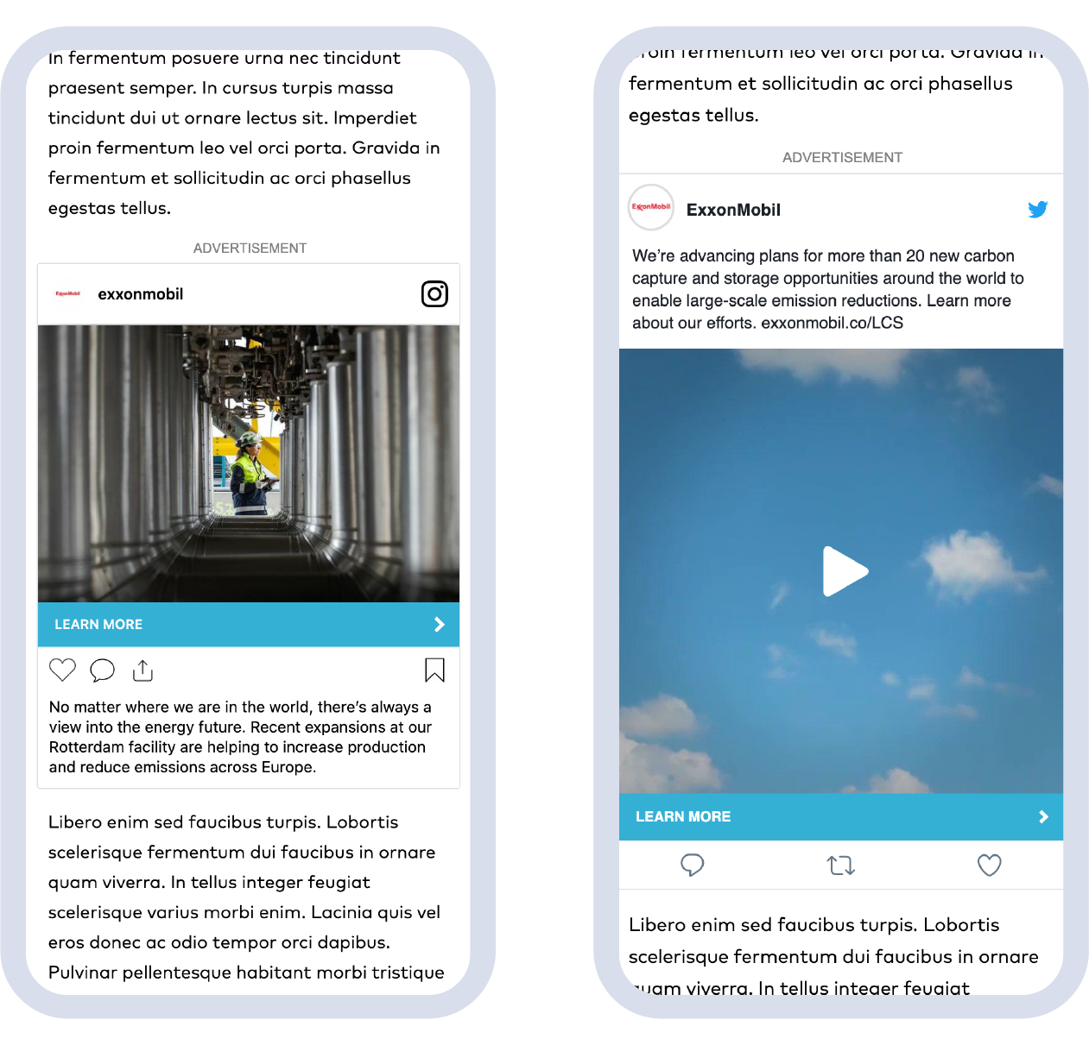
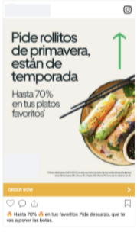
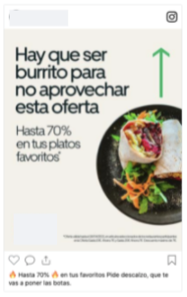
Rideshare Brand
Better cost-per-click
Major global rideshare and food delivery brand reduced the cost-per-click compared with both standard display and paid social by using our ads in display inventory on the web.
$1.53
Avg. CPC
68%
Avg. viewability

Slide 16
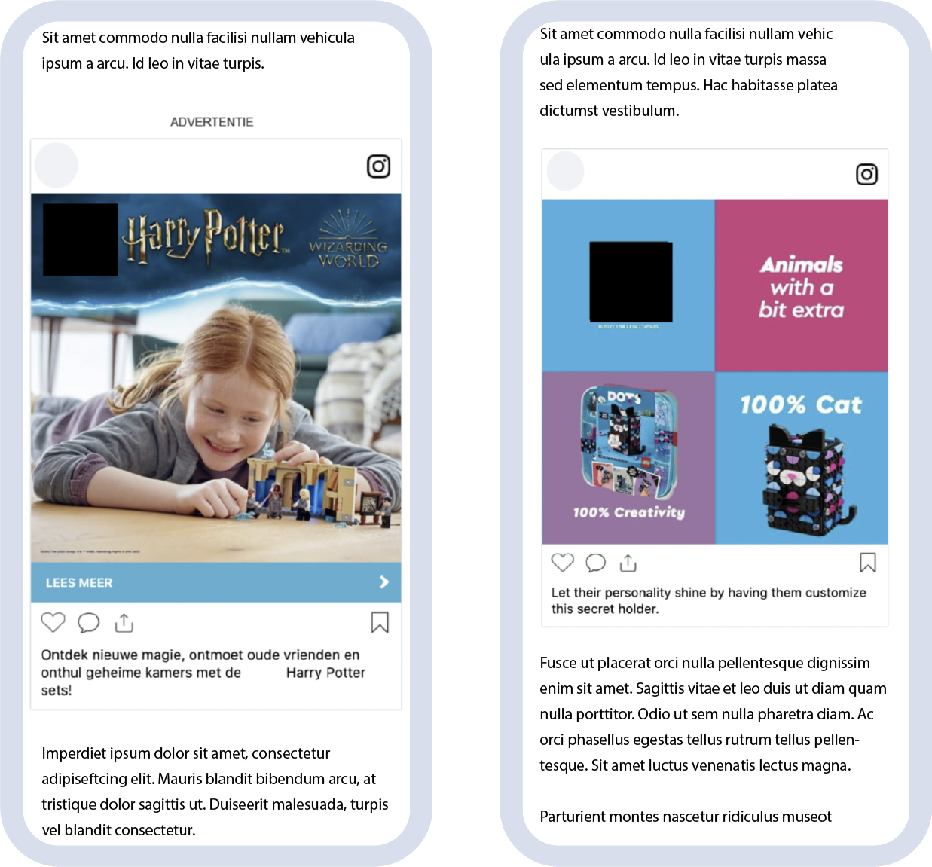
Global Retail Brand
Channel diversification
Inspired by the Facebook ad boycott, global retail brand shifted significant spend away from social platforms to reach new audiences in brand safe environments.
12
Countries activated Social Extension
12
42m
Ad impressions outside of social
Countries activated Nova
Ad impressions outside of social

Slide 17
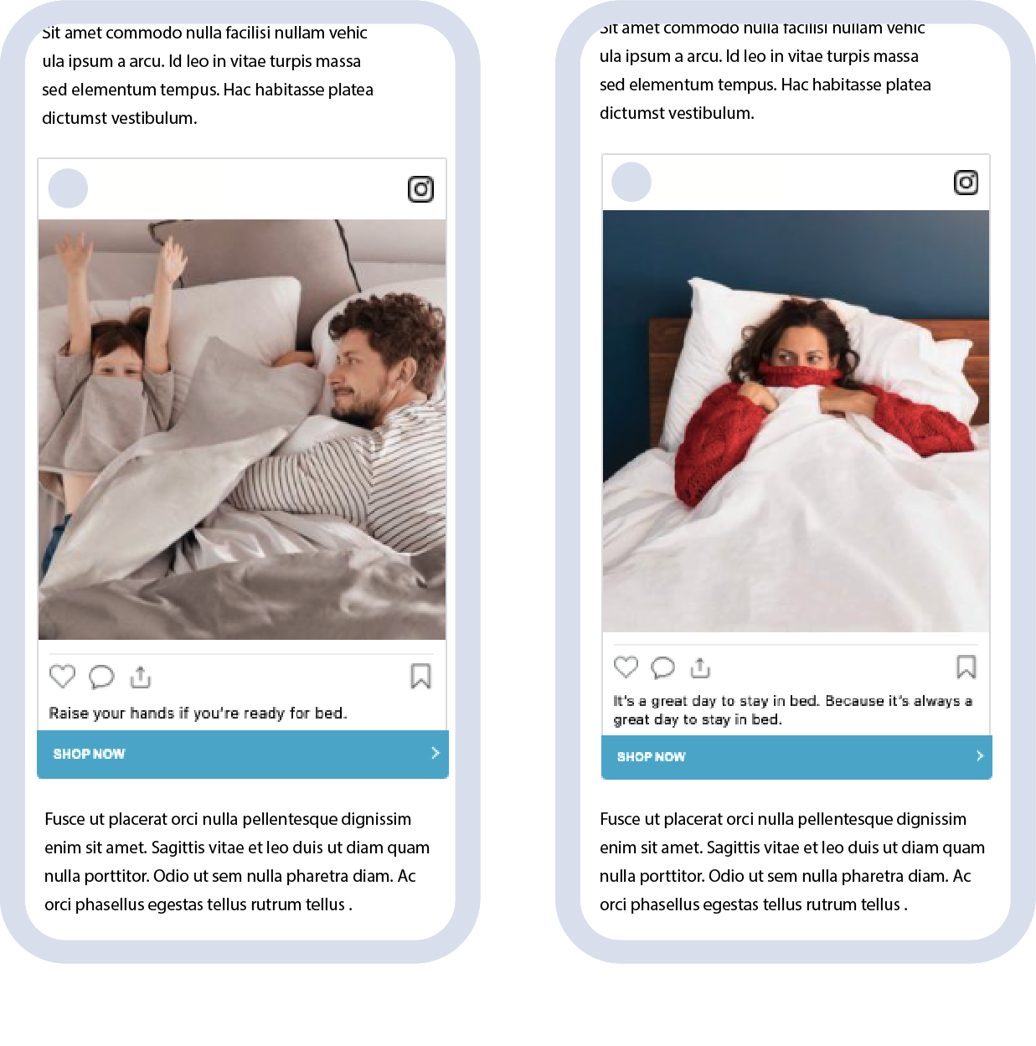
D2C Furniture Brand
CTV Retargeting
D2C bedroom furniture brand increased direct response visits to their website using Social Extension.
18x
More site visits than TV-only strategy
2x
More site visits than TV + standard display
18x
2x
More site visits than TV-only strategy
More site visits than TV + standard display

Slide 18
Thank You

